Slide 1

Note: The data and information in this document is reflective of a hypothetical situation and client. This document is to be used for KPMG Virtual Internship purposes only.
Sprocket Central Pty Ltd
Data analytics approach
[Division Name] - [Engagement Manager], [Senior Consultant], [Junior Consultant]

Slide 2
Note: The data and information in this document is reflective of a hypothetical situation and client. This document is to be used for KPMG Virtual Internship purposes only.
Agenda
Introduction
Data Exploration
Model Development
Interpretation

Slide 3
Note: The data and information in this document is reflective of a hypothetical situation and client. This document is to be used for KPMG Virtual Internship purposes only.
Introduction
About Dataset:
Sprocket Central Pty Ltd provided us 3 datasets:
Customer Demographic
Customer Addresses
Transactions data
New Customer List.
Steps Taken:
Data Cleaning → Cleaned for better quality
Data Transformation → Merged the transactions, customer demographic, customer address
Data Exploration → Explore the data to reveal insights
Problem Statement:
Sprocket Central Pty Ltd , a medium size bikes & cycling accessories organization, has given us a new list of 1000 potential customers with their demographics and attributes.

Slide 4
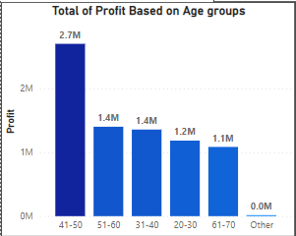
Note: The data and information in this document is reflective of a hypothetical situation and client. This document is to be used for KPMG Virtual Internship purposes only.
Data Exploration
Total Profit Based On Age Group
Insights:
The customers between 30 to 49 age are the most profitable.
Place any supporting images, graphs, data or extra text here.

Slide 5
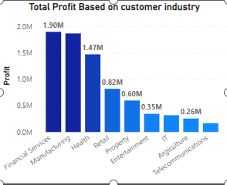
Note: The data and information in this document is reflective of a hypothetical situation and client. This document is to be used for KPMG Virtual Internship purposes only.
Data Exploration
Total Profit based on customer industry
Insights:
Financial Services is the most profitable customer industry.
Place any supporting images, graphs, data or extra text here.

Slide 6
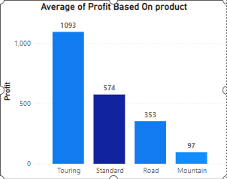
Note: The data and information in this document is reflective of a hypothetical situation and client. This document is to be used for KPMG Virtual Internship purposes only.
Data Exploration
Avg Profit Based On Product
Insights:
Touring is the most avg profit product.
Place any supporting images, graphs, data or extra text here.

Slide 7
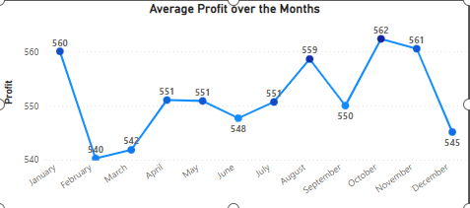
Note: The data and information in this document is reflective of a hypothetical situation and client. This document is to be used for KPMG Virtual Internship purposes only.
Data Exploration
Avg Profit over the months
Insights:
October & November has most profitable months.
Place any supporting images, graphs, data or extra text here.

Slide 8
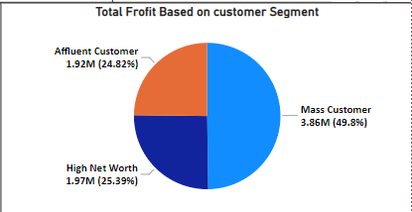
Note: The data and information in this document is reflective of a hypothetical situation and client. This document is to be used for KPMG Virtual Internship purposes only.
Data Exploration
Total profit based on customer segment.
Insights:
Mass Customers are most Profitable almost 50% profit.
Place any supporting images, graphs, data or extra text here.

Slide 9
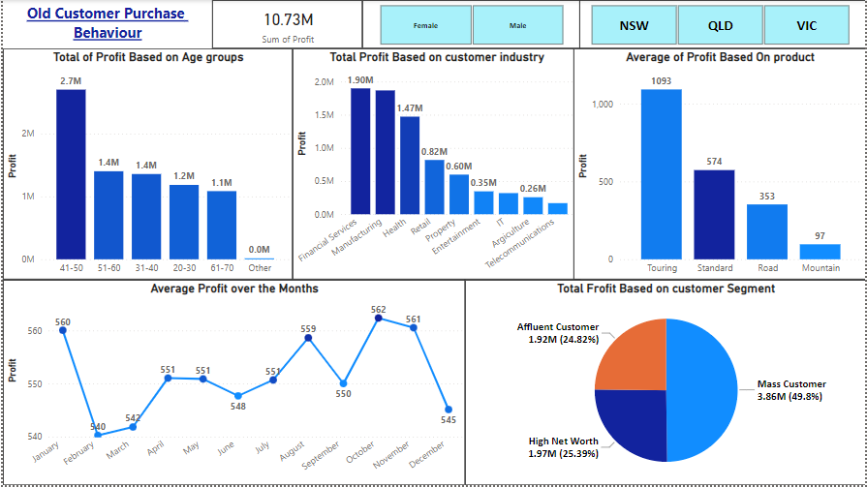
Note: The data and information in this document is reflective of a hypothetical situation and client. This document is to be used for KPMG Virtual Internship purposes only.
Model Development
Marketing team should deploy the targeted model based on -
Customer between age 30 to 49.
Most profit in October & November months.
Customers in the Mass Consumer Segment.
Customers related to Financial Services and Manufacturing Industries.
Touring & Standard product as the top priority.
Customers living in New South Wales.
Place any supporting images, graphs, data or extra text here.

Slide 10
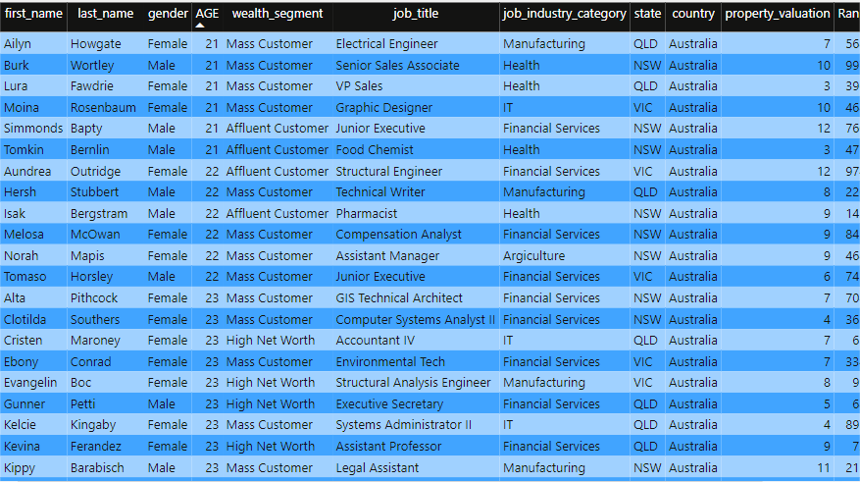
Note: The data and information in this document is reflective of a hypothetical situation and client. This document is to be used for KPMG Virtual Internship purposes only.
Interpretation
After Cleaning the targeted customers from the New Customer List, it will look like below -

Slide 11
Note: The data and information in this document is reflective of a hypothetical situation and client. This document is to be used for KPMG Virtual Internship purposes only.
Appendix

Slide 12
Note: The data and information in this document is reflective of a hypothetical situation and client. This document is to be used for KPMG Virtual Internship purposes only.
Appendix
This is an optional slide where you may place any supporting items.

